Slide 1
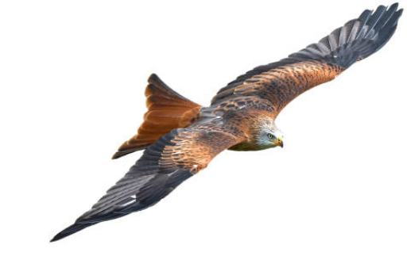

Welcome to Kites

Slide 2
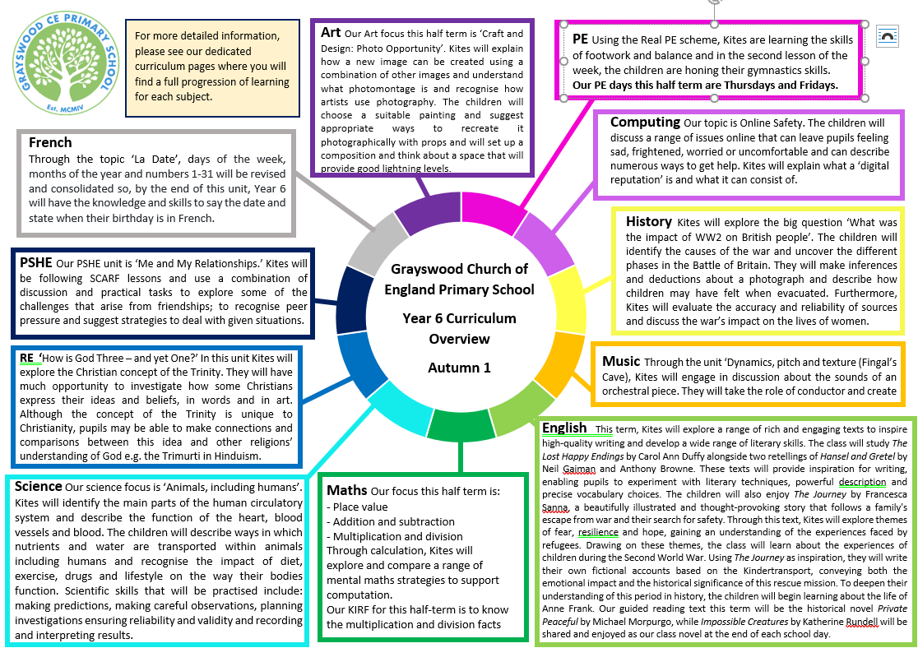

Slide 3
A day in the life of a year 6…
8:35am | Bell and registration
8:50am | Assembly
9:15am | Maths
10:15am | Break
10:30am | Guided Reading/ERIC
11am | English
12pm | Mental Maths
12:15pm | Lunch
1:20pm | Foundation subject
2:20pm | Foundation subject
3:20pm | Home

Slide 4
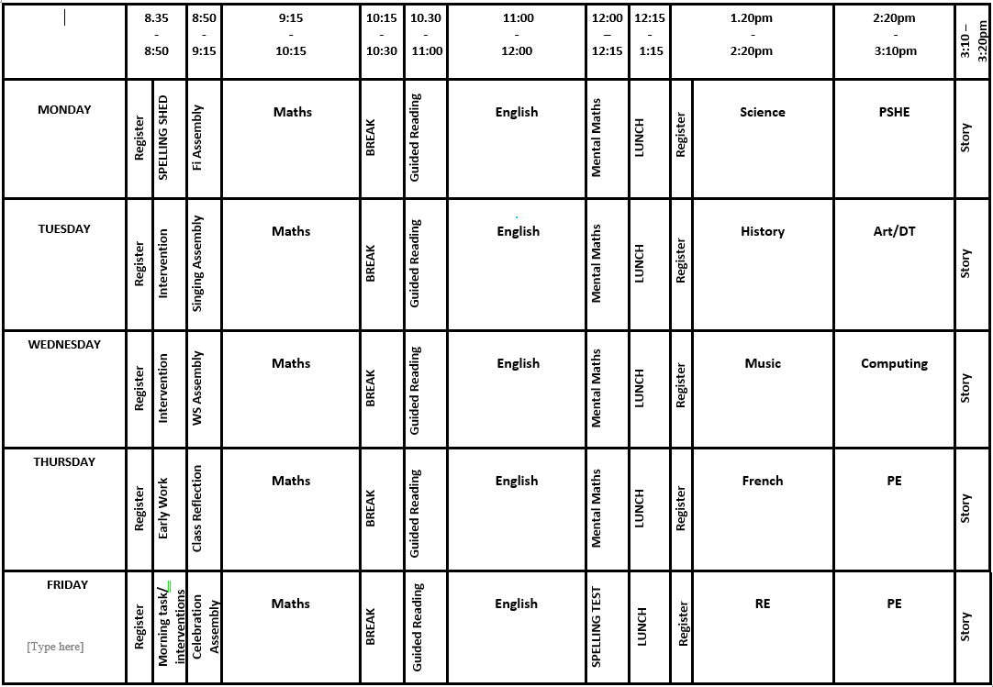

Slide 5
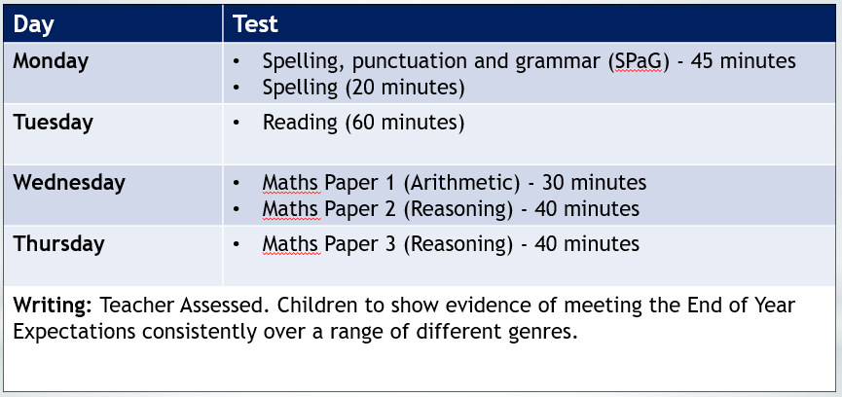
SATs – W/C 10th May 2027

Slide 6
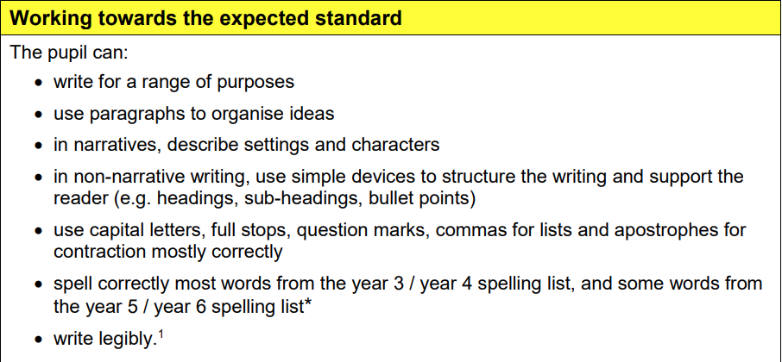
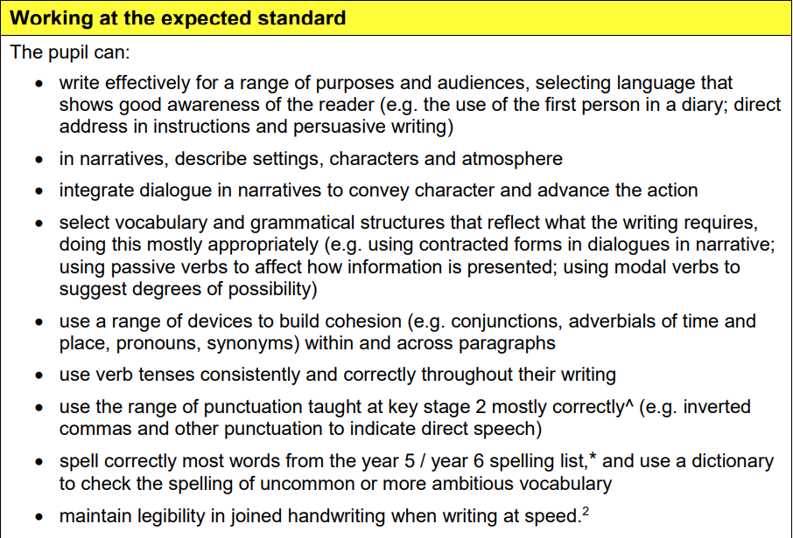
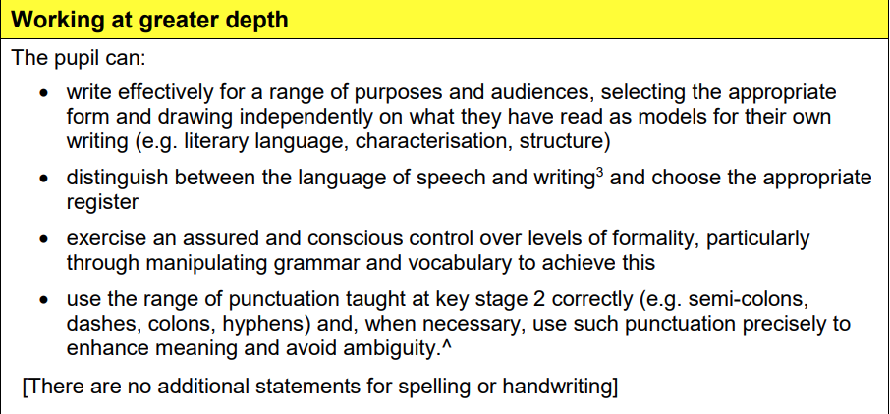
Writing
Immersive and text driven
Audience and Purpose – real reasons to write
Oracy and talk
Working Wall chart
Drama/ Immersion – stepping into characters’ shoes
Fun and engaging units
A craft – writing process made explicit
Whole host of genres
Twinned with reading

Slide 7
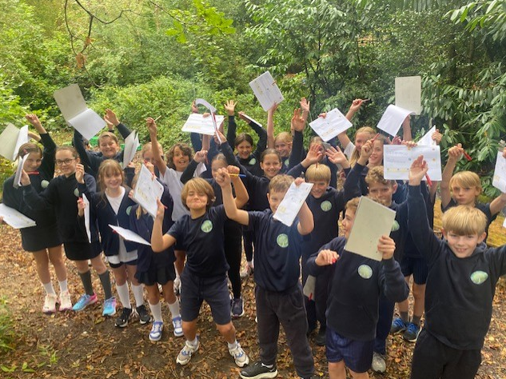
English Kites will explore a range of rich and engaging texts to inspire high-quality writing. The class will use The Lost Happy Endings by Carol Ann Duffy alongside two retellings of Hansel and Gretel by Neil Gaiman and Anthony Browne. These texts will serve as powerful stimuli for writing, enabling pupils to develop and apply a range of literary techniques including figurative language and precise vocabulary choices. The children will also study The Journey by Francesca Sanna—a beautifully illustrated and thought-provoking book that tells the story of a family's escape from war and their search for safety. The story captures the fear, resilience and hope experienced by refugees. Drawing on this powerful narrative, Kites will explore the experiences of children during World War II, using Sanna’s story as a stimulus to write their own fictional accounts of the Kindertransport—conveying both the emotional impact and historical significance of this rescue mission. To build further understanding of this era, the children will study the life of Anne Frank. They will listen to interviews and read about her journey, her childhood, her time in hiding, and the diary she kept, to write her biography. The historical novel Private Peaceful by Michael Morpurgo will be our guided reading book whilst Impossible Creatures by Katherine Rundell will be enjoyed at the end of the school day.
Immersive and text driven
Audience and Purpose – real reasons to write
Oracy and talk
Working Wall chart
Drama/ Immersion – stepping into characters’ shoes
Fun and engaging units
A craft – writing process made explicit
Twinned with reading

Slide 8
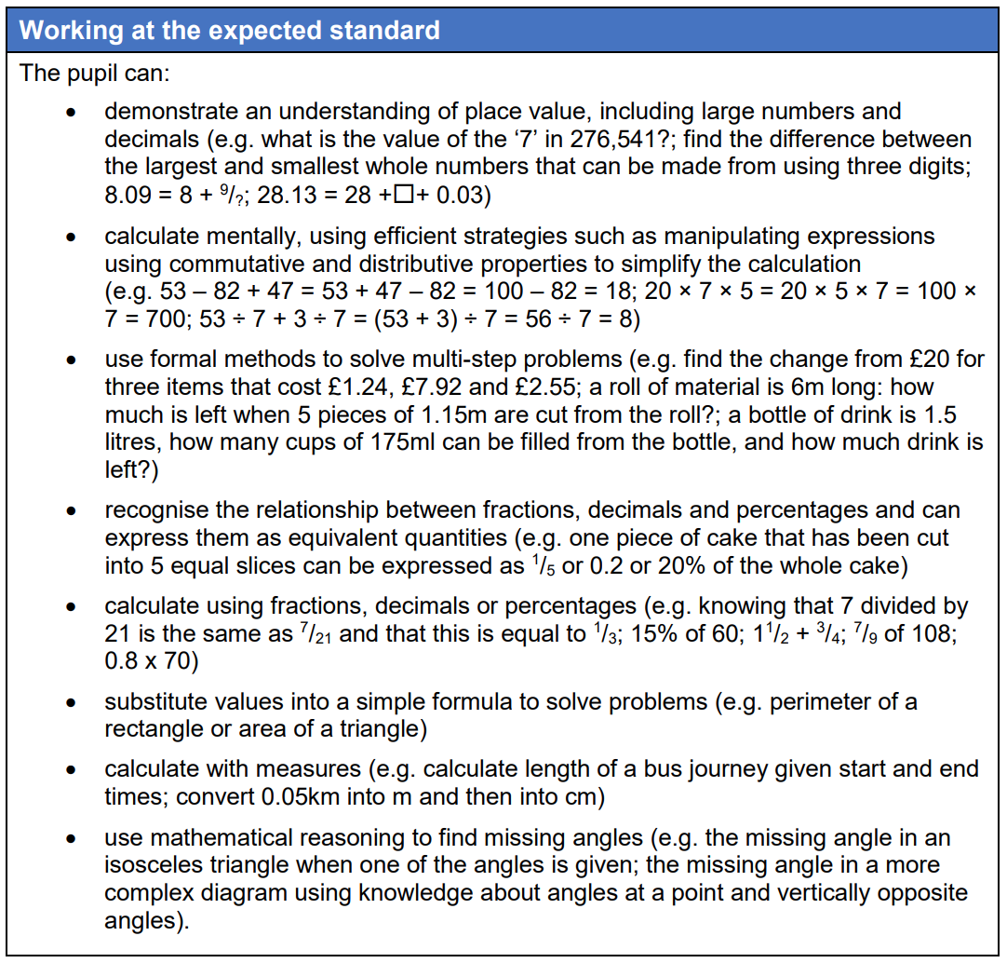
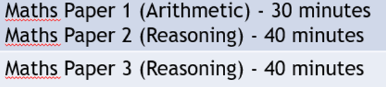
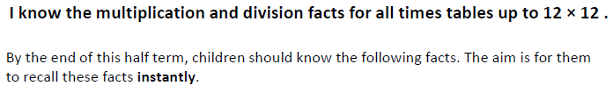
Maths
Layered learning
Conceptual understanding – not just methods but WHY
Problem solving and reasoning
Fluency and accuracy
Visual and practical approaches – models and diagrams
Engagement and challenge – build resilient mathematicians and problem solvers
Autumn 1 KIRF:

Slide 9
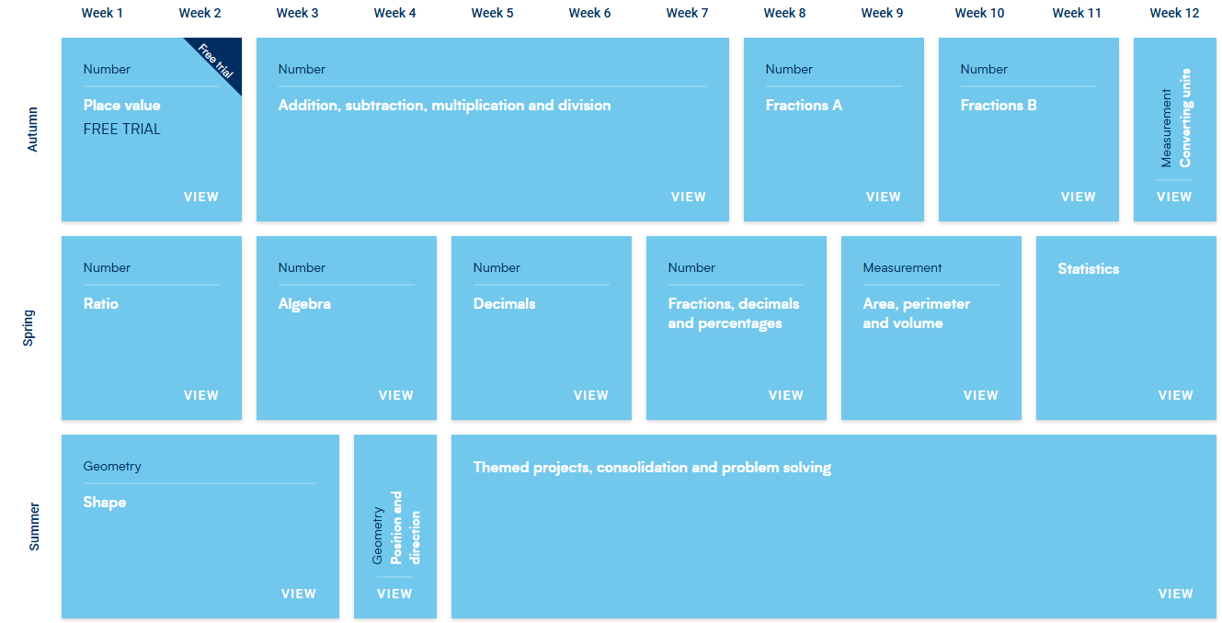

Slide 10
Homework
Maths and English/or another subject to be given every Friday. Handed back in the following Wednesday.
Each week new spellings will be given as homework. These will be linked to the Year 5 and 6 Statutory Spellings.
Spellings will be given out on the Friday, detailed on the Friday note, and tested on the following Friday.
Reading: your child should read daily, either to an adult/sibling or independently, or both!
I will share a link to register on Read Theory on in due course – please complete two-three excerpts per week.

Slide 11
Online platforms
Spelling shed
Mathletics
Read Theory
Please dip into these platforms to support learning. Homework will mostly take the form of paper and pencil!

Slide 12
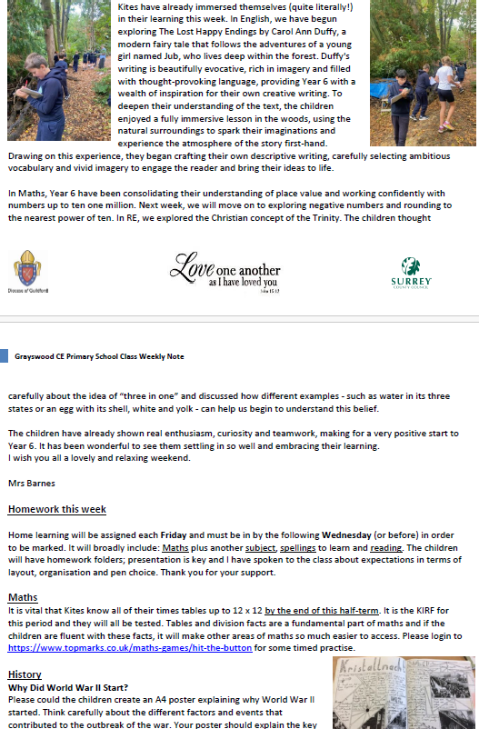
Friday Notes – please read these weekly to keep up to date with the goings on at Grayswood.
Encourage you children to read this too, especially the homework section!

Slide 13
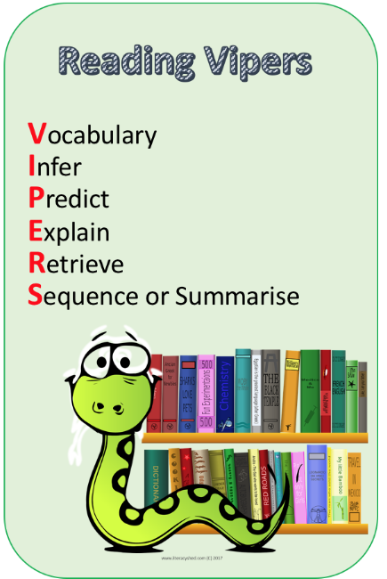
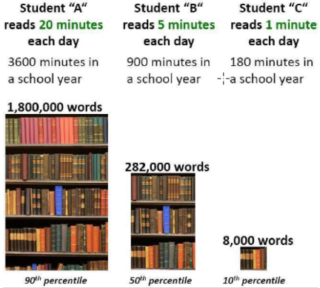
Why can’t I skip my reading tonight?
A study shows the cumulative advantage of daily reading.
A strong correlation exists between reading and vocabulary, writing ability, confidence, access across the curriculum AND maths attainment scores!
Please encourage and help support a routine of daily reading. Thank you ☺

Slide 14
Class library
I have been organising our class library and would gladly receive any donated books which appear on this poster, also featured on this Friday’s note. I want to foster a love of reading – there really is no better pastime!
Sign out sheet – replacing books if lost.
Kites are responsible for changing their own books as and when they need to.
I will be asking the class to complete entries in their reading records to illustrate how often they are reading.
Reading passports were a HUGE HIT last year. I will support choices:

Slide 15
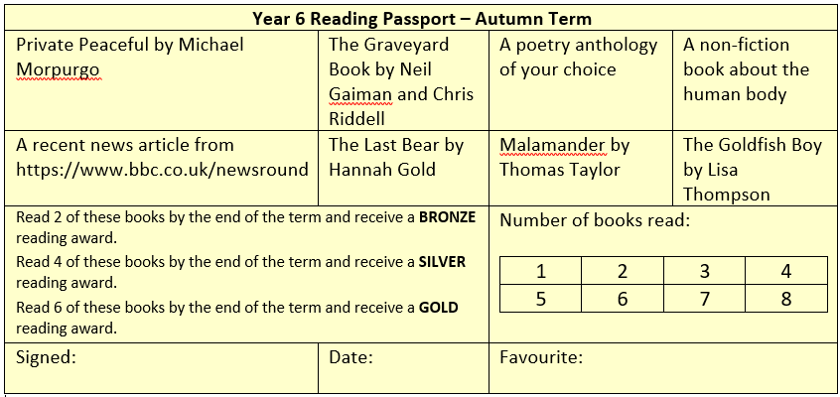
A draft version of one example of a reading passport – this is to support reading choices and motivate pupils!

Slide 16
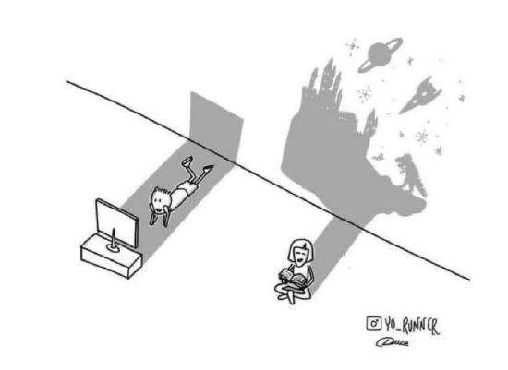
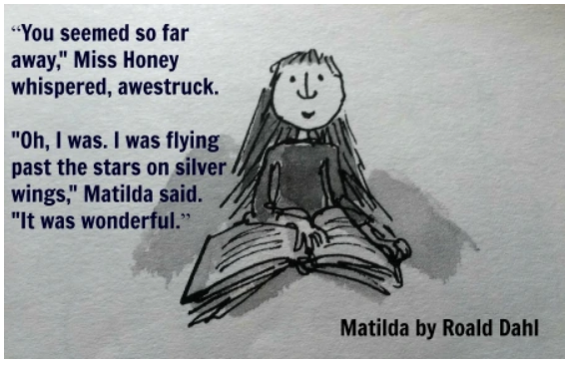
We are really pushing reading for pleasure here at Grayswood because, quite simply, aside from the academic advances one makes due to reading, it is FUN ☺

Slide 17
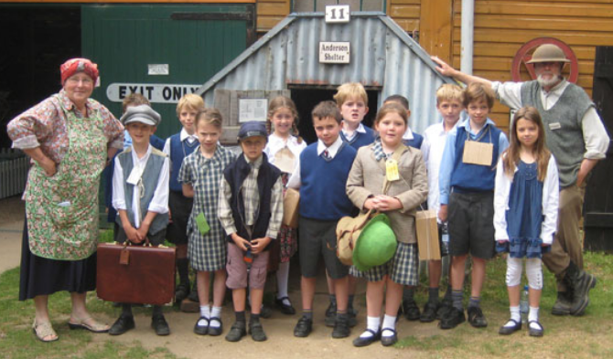
Forest School
Kites will enjoy Forest School in the Spring or Summer Term –tbc
Class trips
This term we will visit The Rural Life Centre to support our learning of WW2. Next term we are off to the Gilbert White museum. Volunteers needed!
Parent Helpers/ DBS

Slide 18



Year 6 Responsibilities
Your child has selected a few roles they would like to be responsible for. These include the role of School Ambassador, Eco-Warrior, Computing monitor, School Council, House Captain, Sports Captain, Sports Crew, Wellbeing Ambassador and Reading Prefect
Miss Cole will be interviewing for the position of School Ambassador over the next fortnight.
I will be in touch with you all regarding your child’s role! EVERY role is valued.

Slide 19

Thank you for listening! I look forward to seeing you all again at our forthcoming Parent’s evening.

