Slide 1
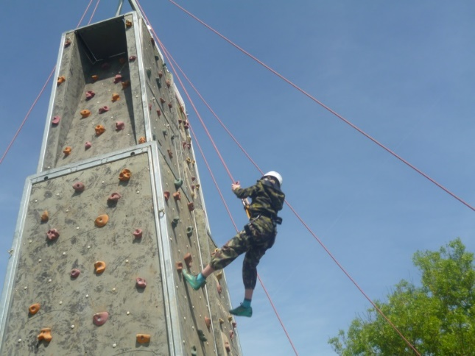
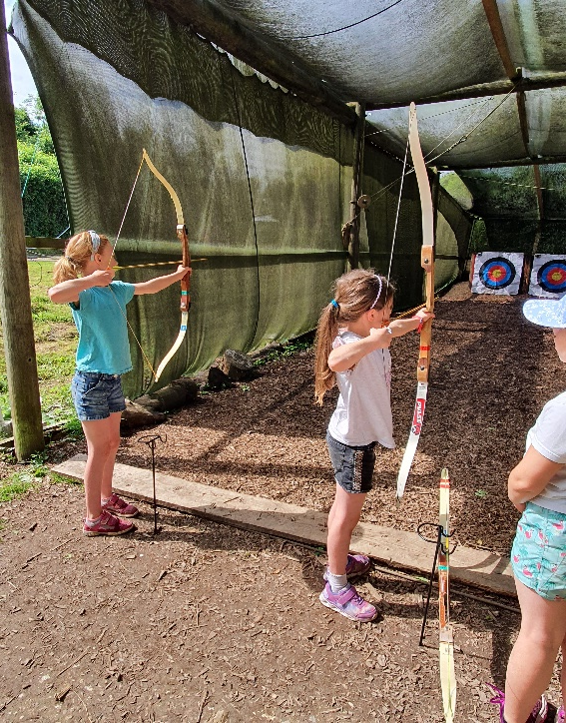
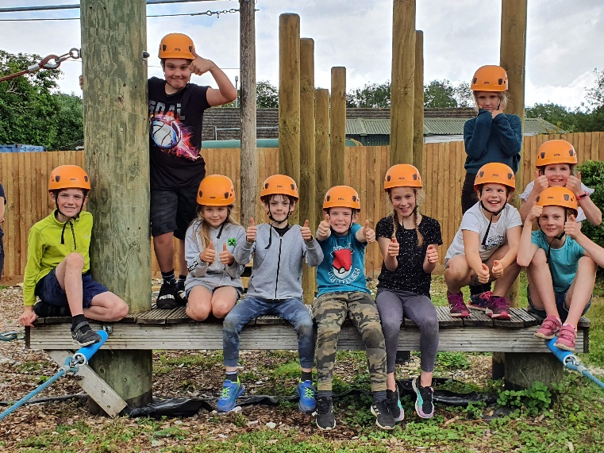
Year 4 Residential to Henley Fort
24th – 26th June 2026
CHALLENGE, LEARN & ACHIEVE

Slide 2
What is Henley Fort and why are we going?
Henley Fort is an Outdoor Education Centre based in Guildford. It is a Victorian Fort built during the late 19th Century to protect London from invasion by the French; later it was used by the Home Guard in World War 2 as a re-supply depot. It is now an outdoor education facility offering groups a chance to take part in challenging activities or a living historical experience.

Slide 3
Why a residential and not a day trip?
Invaluable part of the National Curriculum
Children benefit enormously from the experience, both educationally and socially
Fully immersive learning experience
Opportunity to try new things and take risks
Gives children the chance to become more independent and to learn something of tolerance
and responsibility
A very enjoyable and enriching experience in the widest sense!

Slide 4


Slide 5

SOLD outdoor learning and development
A range of outdoor learning activities for all ages and abilities
What activities will my child be doing?
Team work and Challenge Course
Bouldering and climbing
Orienteering and team tasks
WW2 immersive morning/evening
Woodland skills
Campfires

Slide 6
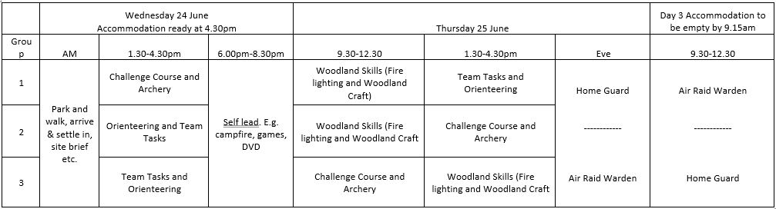
Activity Programme
Please ensure your child brings a packed lunch on
Wednesday 24th June.
Please remember we are a nut free school.
A full kit list will be in the information pack, which will
be sent out after this meeting.

Slide 7
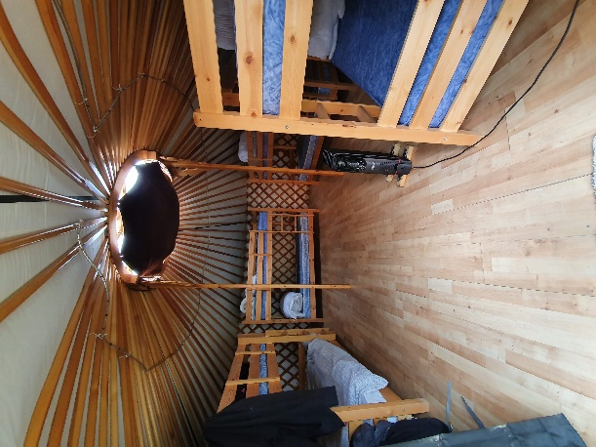
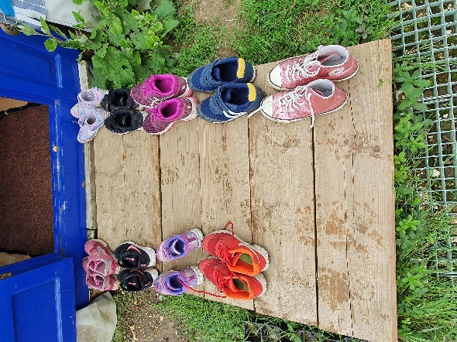
Accommodation
Mongolian Yurts provide a unique residential stay!
Each yurt sleeps between 8 and 12 people in sturdy bunk beds, has several bean bags, hanging storage, internal rope lighting and a heater if needed.
There is also a marquee available in the Yurt Village for groups to meet during free time.
Female and male toilets and
showering facilities are next to
the village.

Slide 8
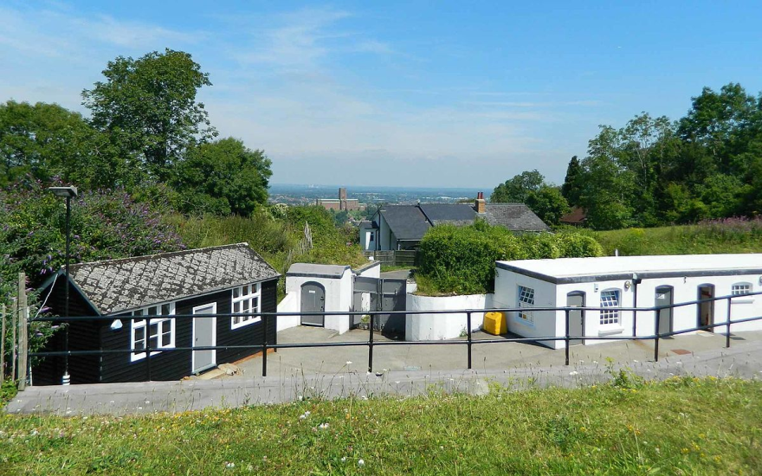
Who will be going?
In addition to the centre specialists, who will lead the majority of the activities, the following staff will be accompanying the children on the residential:
Mrs Breslaw
Mrs Spicer
Mrs Reilly (day)
Mrs Barnes (evening)
How are we getting there…?

Slide 9
Eating?
All parents will complete a dietary requirement sheet prior to the trip to ensure the staff at Henley fort cater for any allergies or intolerances. The children will have three meals a day; Breakfast, lunch and dinner.
No parent should pack extra food for their child please. They can bring a small ‘sweet’ treat for their child for each day. Just a little something of their/your choice. Again, please remember these must be nut free.
These will be confiscated on arrival and given out throughout
the 3 days.

Slide 10
What happens at night time?
Activity during the early evening.
Children have some time in their rooms (tidying, washing, getting ready for bed and reading)
Lights out at 10pm.
If a child is struggling to get to sleep the staff will support them and then give them plenty of reassurance. Staff sleep with one eye open! Children are made aware of where staff are during the night if they need help.

Slide 11
What do they leave at home?
Their worries- they'll have a great time!
Any electrical device including cameras-we will take lots of photos.
Any communication device, no mobile phones,
tablets etc
Money - there is no tuck shop on site.
Their family- sorry there isn't room for you!

Slide 12
Kit List
Land-based activity day/s
Appropriate clothing for the weather - jumper, trousers, long sleeved t-shirt
Old pair of trainers (flip-flops, crocs or open back/toe shoes are not suitable)
Warm coat
Waterproofs
Hat and gloves/sun cream and sun hat
Water bottle and a nut-free packed lunch (if you have not booked catering with us)
Yurt residential at Henley Fort
Towel and wash kit
Slippers or thick socks to wear around the yurt
Any medication
Torch- the centre is in a remote location and very dark
Snacks, nut-free (in a sealed container)
Extra clothes for the following day(s)
All bedding is provided for yurt residentials.

Slide 13
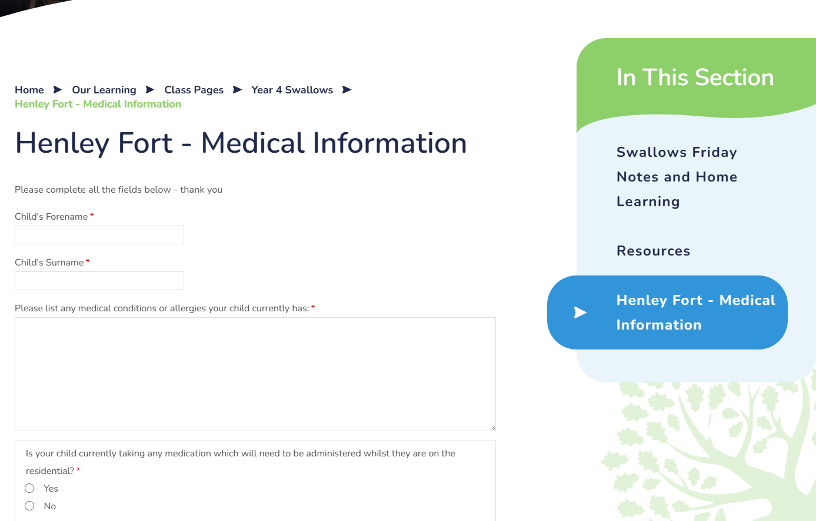
Medical Form
Please start filling out the form.

Slide 14
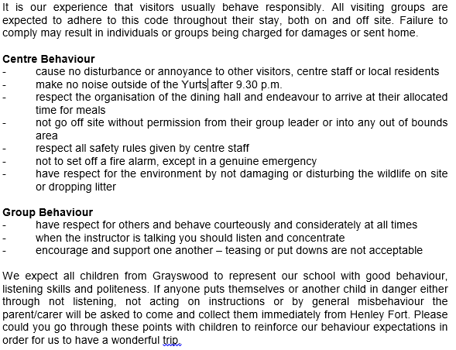
Code of Conduct

Slide 15
Any Questions?

Slide 16


