Slide 1
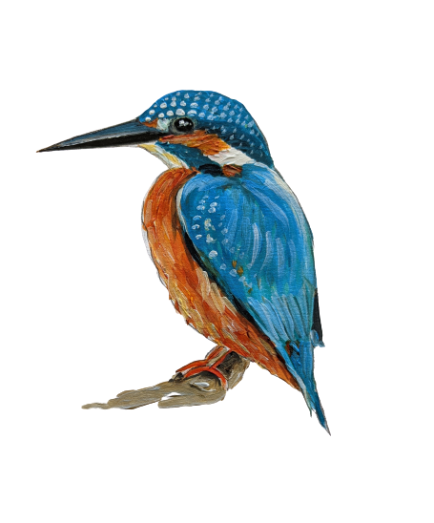

Welcome to Kingfishers
Year 3, Lower Key stage 2
Grayswood CE Primary School

Slide 2

A typical day in Kingfishers…
Children need to be in school by 8.35am
8.35 Bell goes and register is taken
8.40 Handwriting/Spelling/Maths activity
8:50 Assembly
9.20 Maths
10.15 Break – children are welcome to bring in their own fruit/veg
10.30 Guided Reading/Spellings
11:00 English

Slide 3



Afternoon learning
12:00 Mental Maths
12:15 Lunch
1:15 Afternoon Register
1:20 Foundation subject
2:15 Foundation subject
3.20 End of the school day

Slide 4
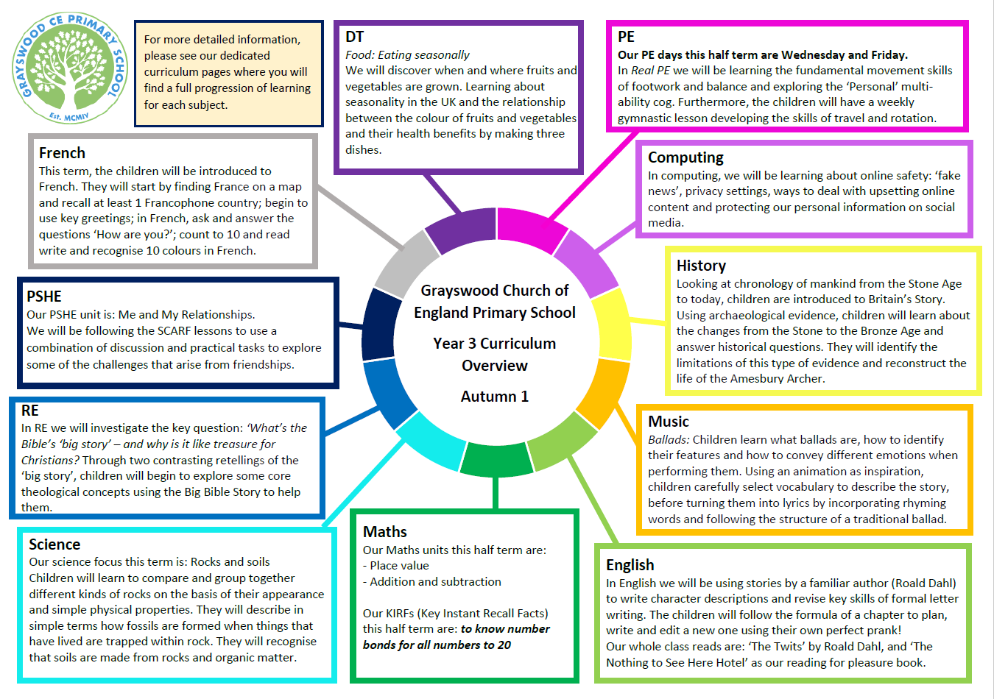
Curriculum overview Autumn term 1

Slide 5

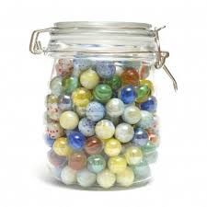
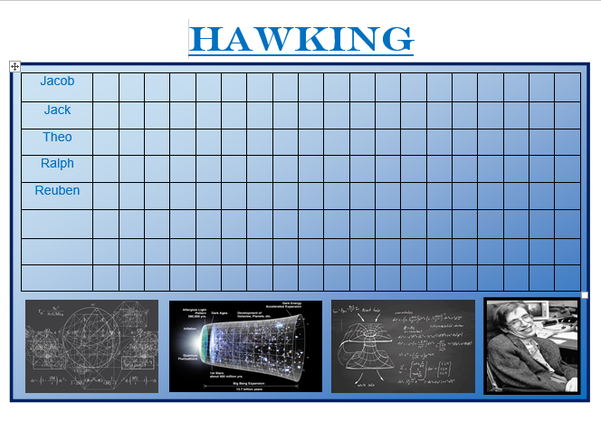
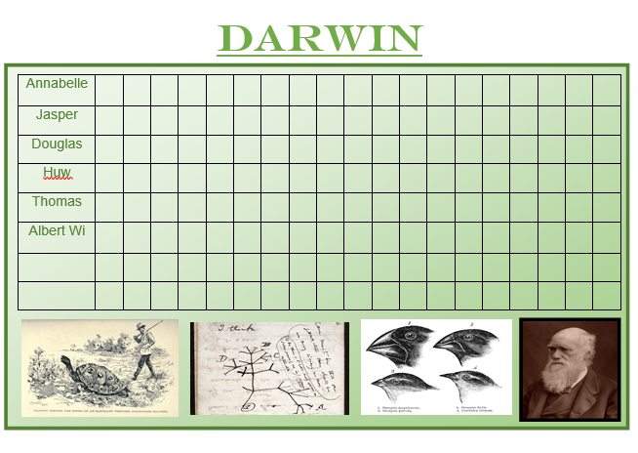
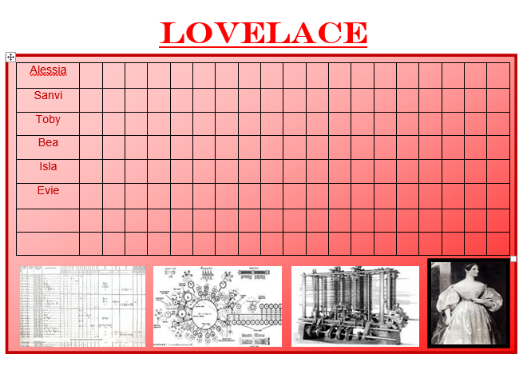
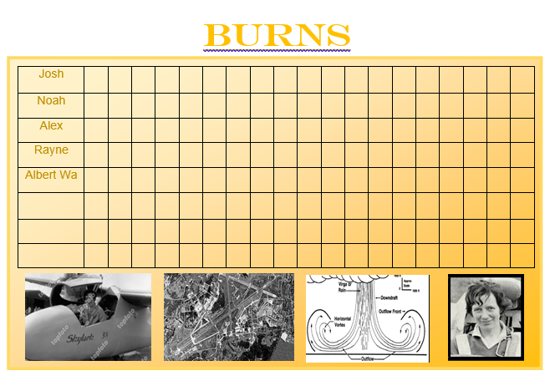
Reward systems
It’s Good to be Green!
House points
Raffle Tickets
Celebration Assembly

Slide 6

PE days
Wednesday – with Mrs Chow
Friday – with Miss Wylie
PE Kit
·Navy sweatshirt
·Navy jogging bottoms/ shorts
·White/Navy logo T-shirt
·White Trainers or black plimsolls
Please can children wear their PE kit into school on these days.

Slide 7
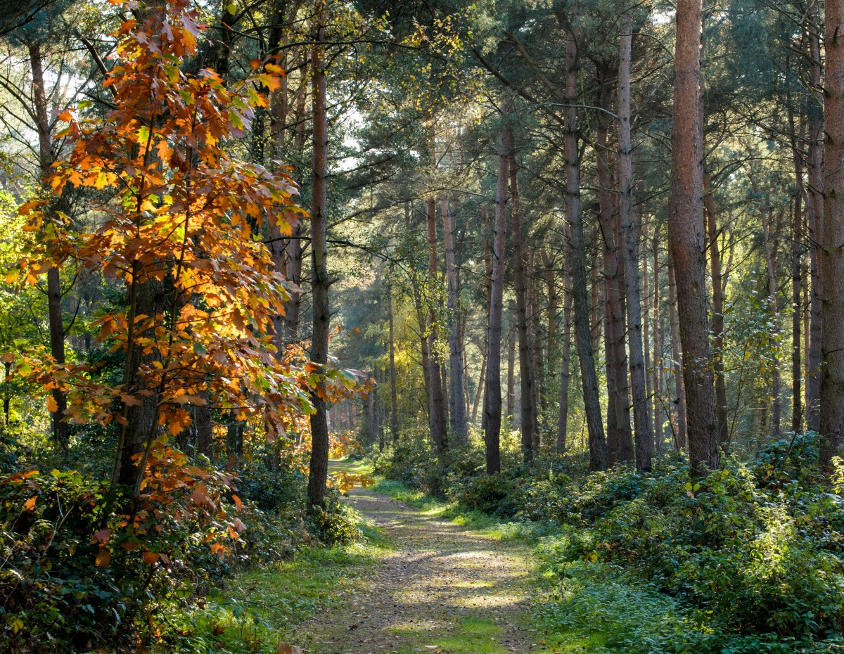
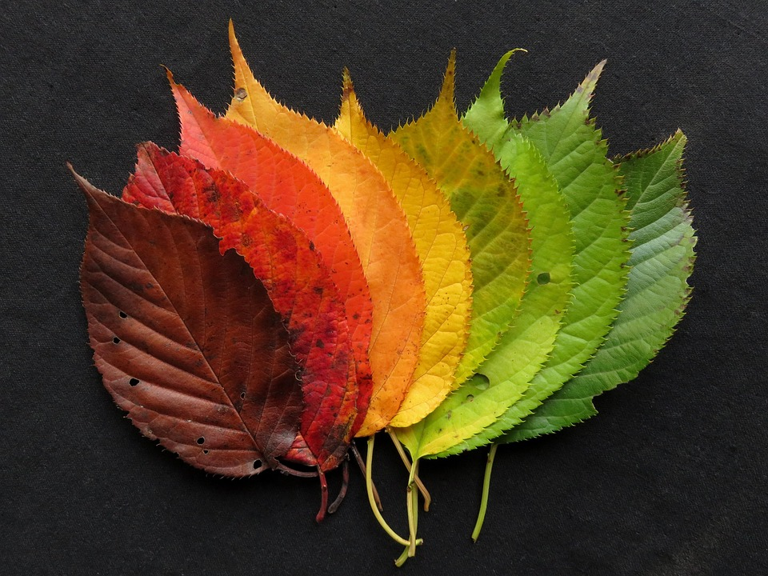
Forest School
Kingfishers will have their Forest School sessions in the Spring term.
Dates/days to be confirmed closer to the time.

Slide 8
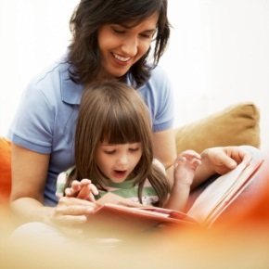
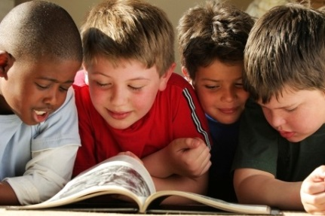
Reading
Please read as much as you can with your child- children should read to an adult at least 3 times a week (ideally more) and this should be recorded in the reading record.
  Fiction: story books, scheme books, comics
  Non-fiction: poems, newspapers
Children can change their book as and when they need to, encouraging independence.
Reading records:
  Should be signed by a parent
  Will be checked regularly
Please bring books and reading records into school everyday

Slide 9
Home Learning
Literacy & Maths
Your child will receive Literacy and Maths or topic home learning
- depending on the week’s learning
Given out on a Friday, to be returned by the following Wednesday.
Spellings
Spellings will be sent home weekly. These will be linked to the Year 3 and 4 Statutory Spellings. Please spend time learning these with your child and testing them.
Spellings will be given out on Friday and tested the following Thursday.
Reading
Children should be reading every day, either with an adult or independently. Please record comments in their reading diary

Slide 10
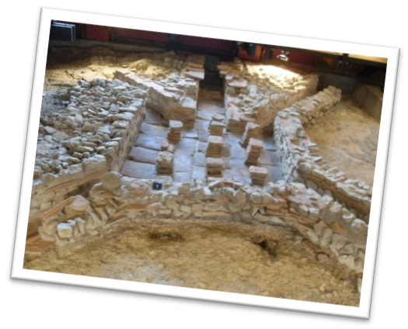
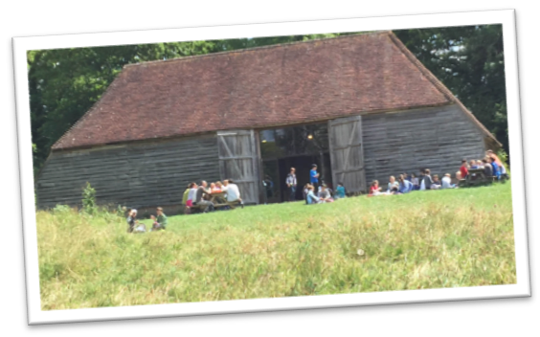
School trips in Kingfishers
Autumn term:
Stone Age Historical Workshop
Spring term:
Fishbourne Roman Palace & Garden
Summer term:
Gilbert White House – Mighty Mapping
Haslemere Museum

Slide 11
Parent Helpers
We are always grateful for parent helpers, especially to support the testing of times tables and reading.
You are required to have a DBS check for this school – please liaise with the ladies in the office to arrange this.

Slide 12
Supporting your child in Year 3
Online
Learning
Home Learning
Reading
Times Tables
Spellings
How can you help your child?
Set aside a quiet time each day when you can support your child with
their home learning tasks.
Encourage them to have
high standards and take pride
in all they do.
Museum visits

Slide 13

Do you have any questions?
Thank you so much for your time!

